Slide 1
Airbnb Review Sentiment Analysis
Priyanka Bhosale

Slide 2
Introduction
Objective: Identify consistently poor-performing Airbnb hosts in Chicago through Sentiment Analysis
Significance: Impact on user experience, Airbnb’s reputation, and potential deterrent to future bookings.
Goal: Enhance service quality by proactively addressing hosts with negative reviews.

Slide 3
Dataset Overview
Data Sources: Kaggle dataset from Airbnb web scraping
Data Preprocessing: Merging datasets, handling missing data by dropping irrelevant columns and eliminating incomplete rows.
Dataset size: 355,888 reviews in total.

Slide 4
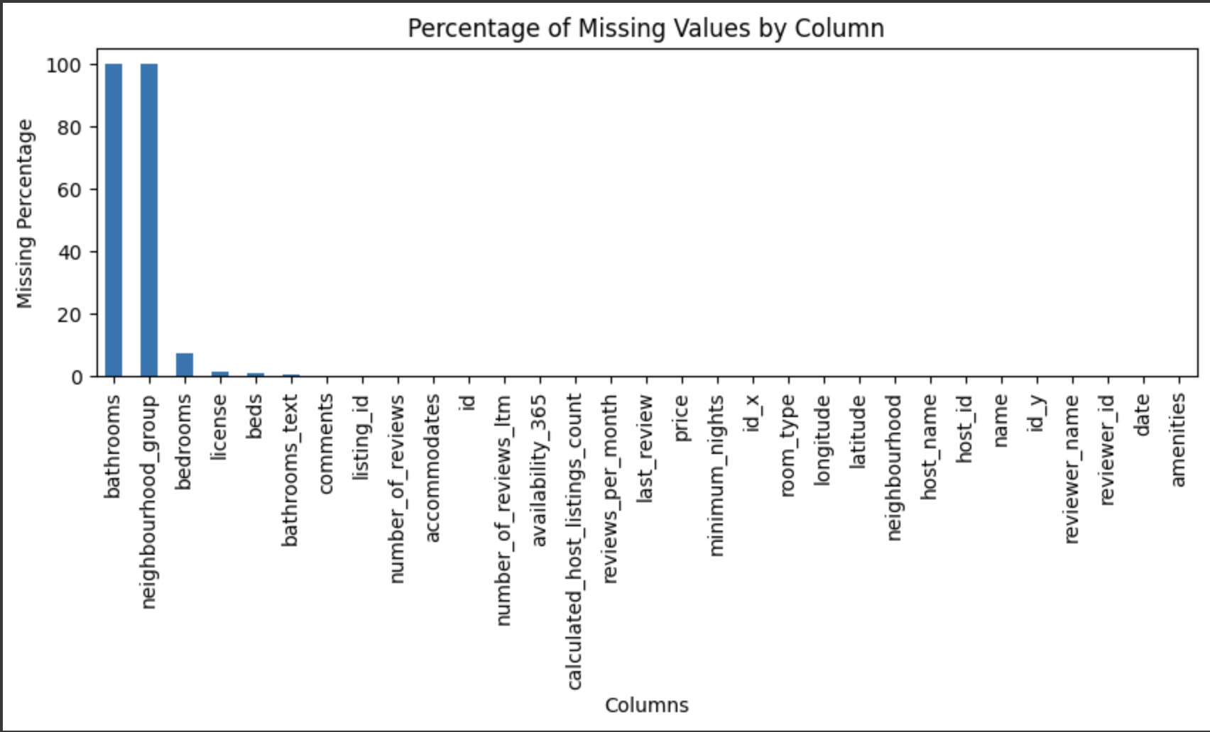
Missing Values

Slide 5
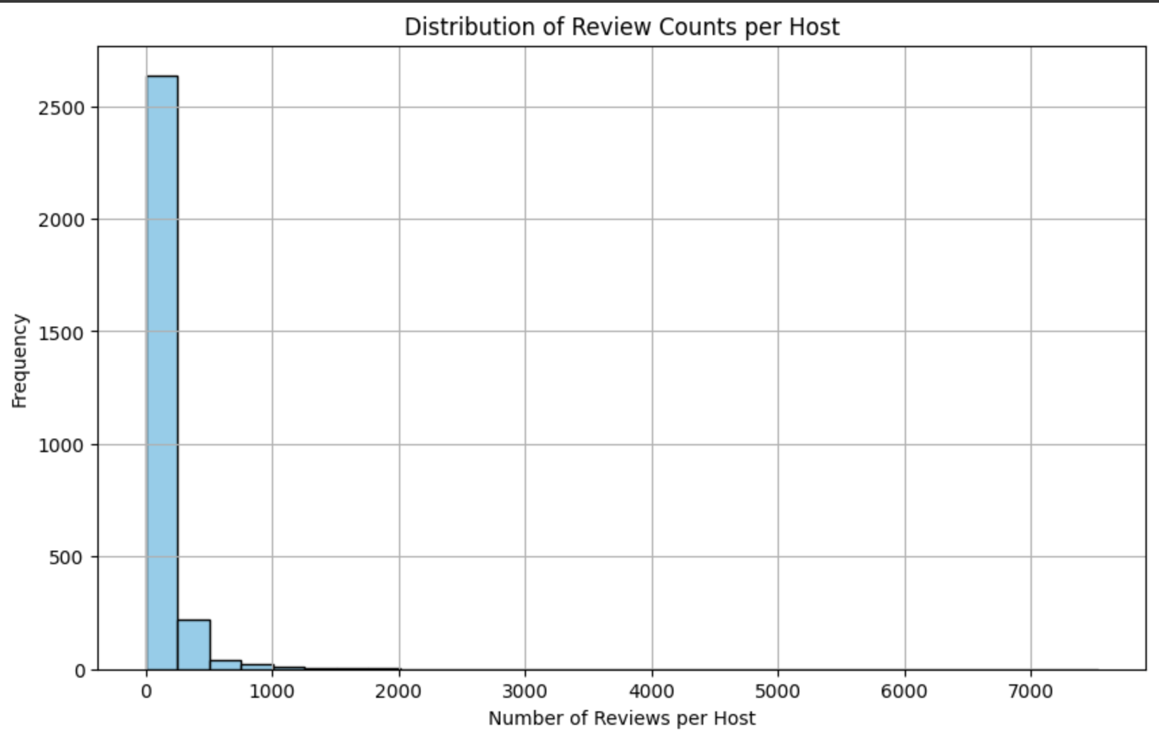
Number of reviews per host

Slide 6
Methodology
Lexical Methods: VADER (Valence Aware Dictionary eSentiment Reasoner) and TextBlob for initial sentiment analysis.
VADER: Categorized sentiment scores based on thresholds (positive, negative, neutral).
TextBlob: Provided polarity (-1 to 1) indicating sentiment strength.
Recurrent Neural Networks: LSTM (Long Short Term Memory) model for deeper sentiment analysis

Slide 7
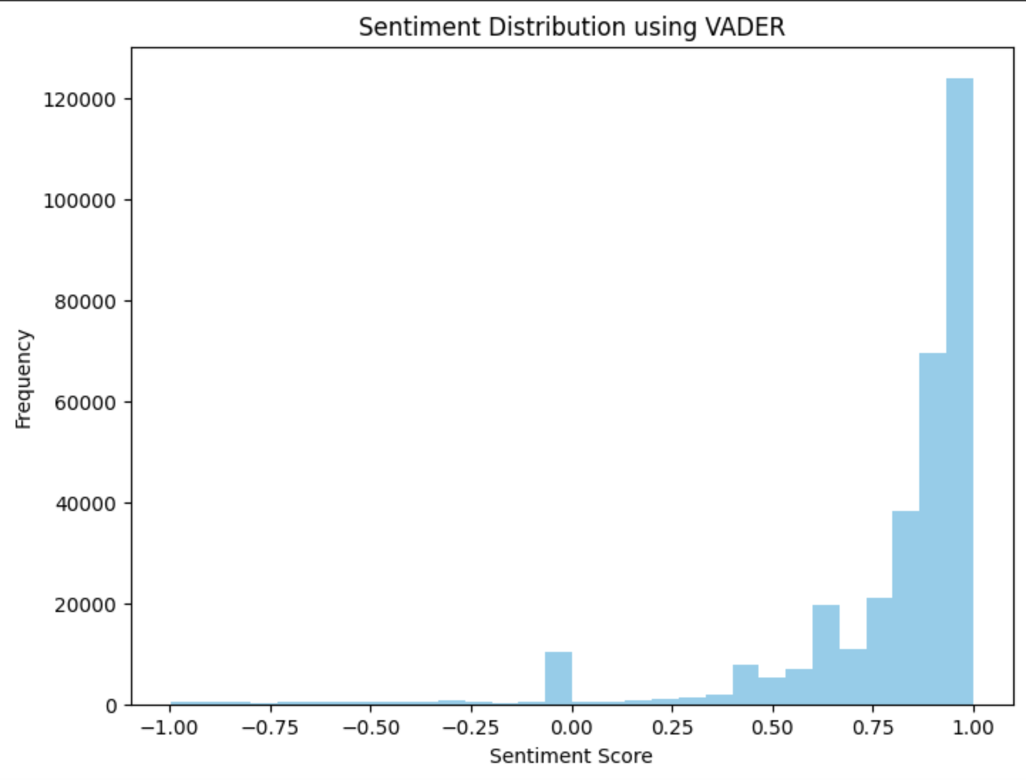

Slide 8
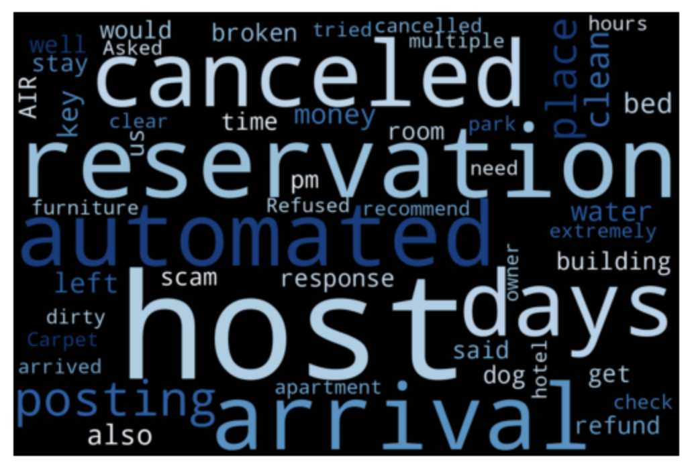
Word Cloud for negative reviews

Slide 9
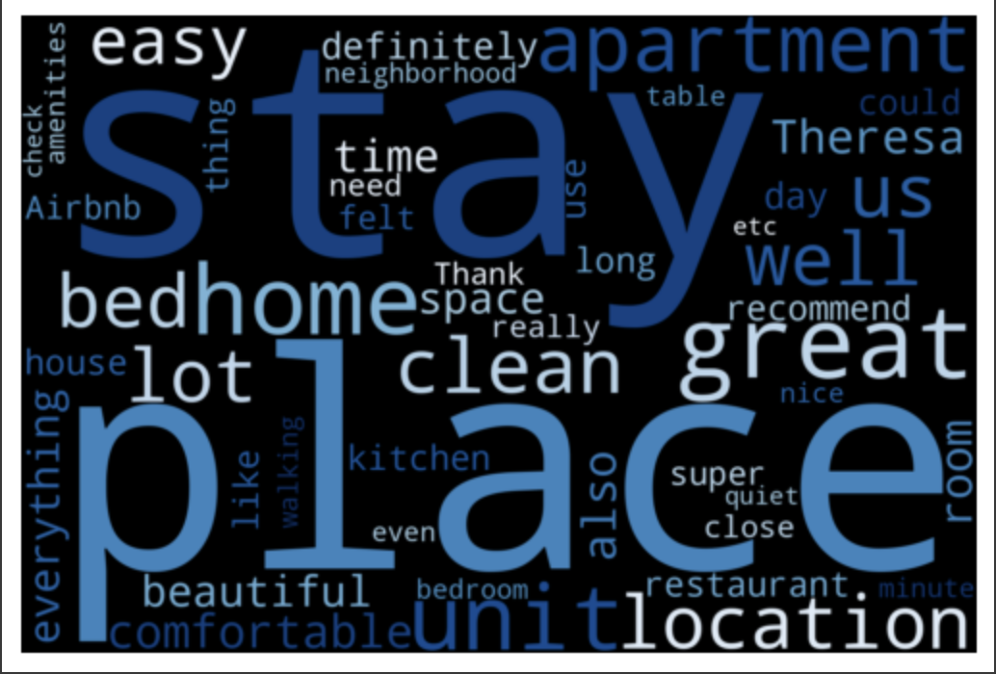
Word Cloud for positive reviews

Slide 10
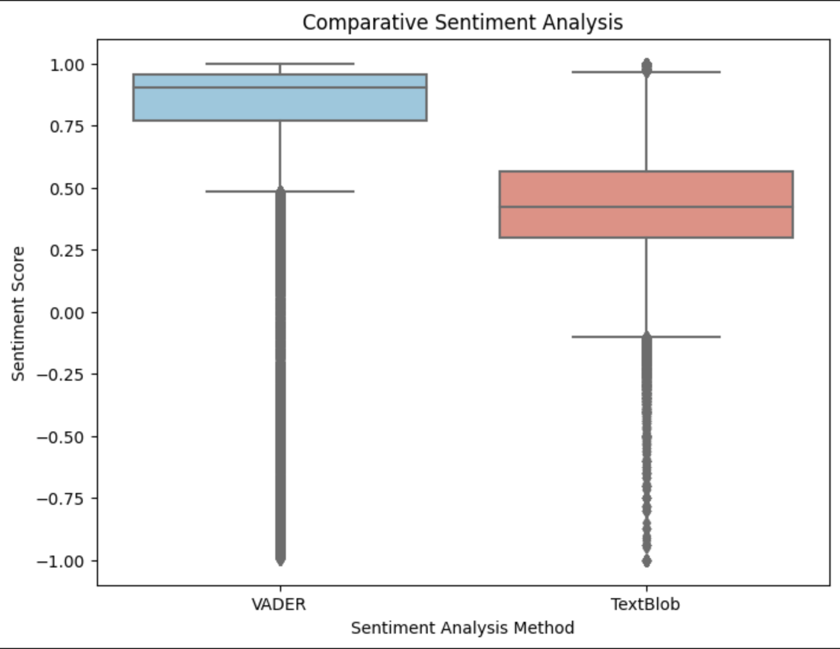
Comparative Sentiment Analysis: VADER vs TextBlob

Slide 11
LSTM Model Results
Accuracy: LSTM achieved 95.38% accuracy on sentiment prediction.
Loss: Average difference between predicted and actual sentiment labels was 0.1386, indicating alignment between predictions and actual sentiments.

Slide 12
Future Work & Recommendations
Feature Engineering: Consider additional host related features for analysis.
Handling Imbalanced Data: Techniques to balance the dataset for improved model performance.
Contextual Embeddings: Integration of pre-trained word embeddings for nuanced sentiment understanding.
Deep Learning Enhancements: Experimenting with alternative neural network architectures for potential improvements.

Slide 13
Thank you

